Slide 1
The HoloTrack System
Presented By: Chris DeMarco and Patrick Rygula
Prepared for: Senior Design Presentations
Faculty Advisor: Dr. Edward Currie
C

Slide 2
Abstract
We present to you a virtual reality environment projected holographically for the purpose of enhancing the experience of treadmill use.
C

Slide 3
Agenda
Introduction
Goals
Technologies
System Design
Methodology
Implementation and Problems
Demonstrations
Results
Concluding Thoughts
C

Slide 4
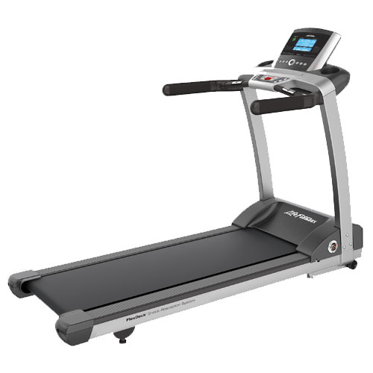
Introduction
Virtual Reality and Hologram Treadmill System
Where did the idea come from?
Solving Boredom and Inspiring Creativity
Simple Controls and Usability
Related Technology?
So What?
P

Slide 5
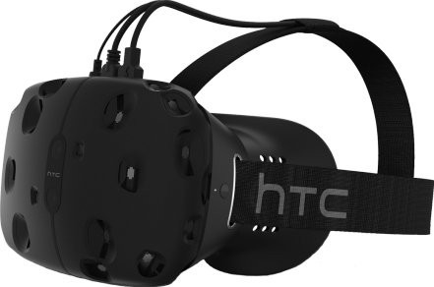
Goals
Holographic Projection Technology
Realistic Look and Feel
Unique and Practical
Convenience of a Home or Gym
System Integration Between Hardware and Software
Low Cost
No Headset
P

Slide 6

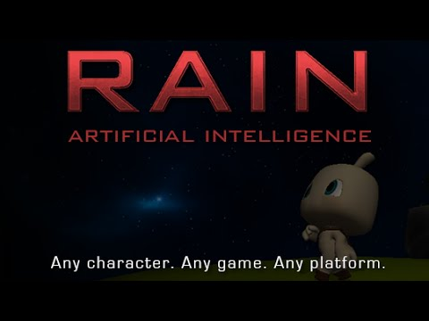


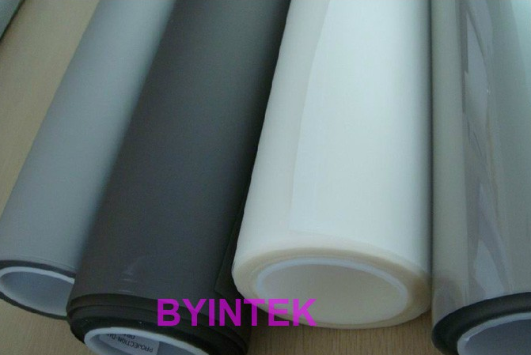
Technologies
P

Slide 7
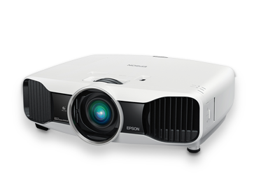


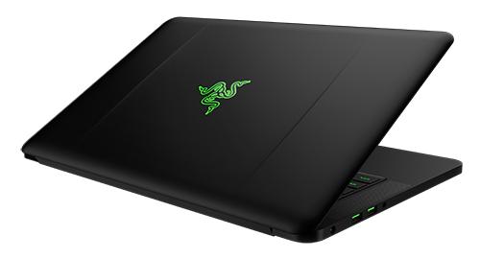
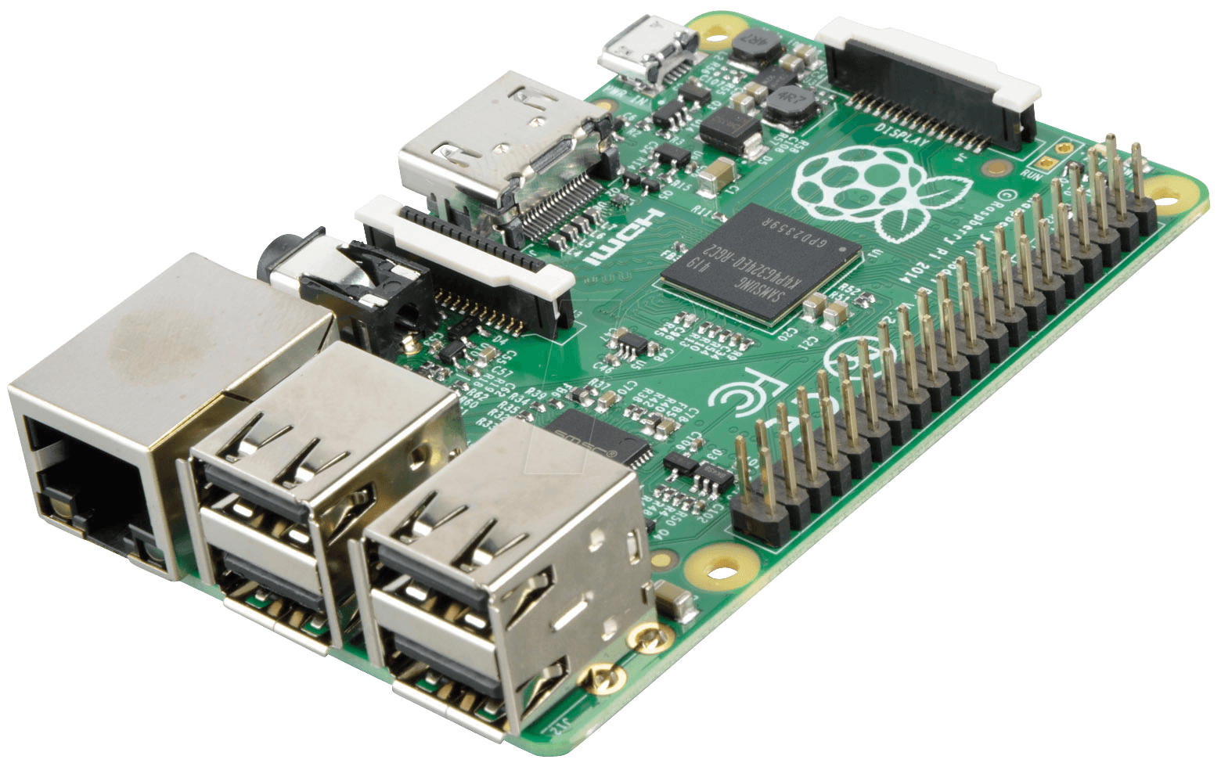
C

Slide 8

Methodology and Plans
Research
Create Terrains in Unity
AI Camera Rotation and Way Points
Raspberry Pi Button Circuitry
Build Prototype Holographic Foil Display
Raspberry Pi to Laptop to Unity Application Communication
Testing Throughout
C

Slide 9
Consult Electrical Engineering Professors for Circuitry
Timeline
10/5/2016
Connect Raspberry Pi and Projector to System
11/2/2016
Order Remaining Items Needed
11/10/2016
Formulate Real Word to Unity Conversions
11/12/2016
Create GUI and Application for Unity Controls
11/19/2016
Feasibility Analysis and Risk Mitigation
Fully Conncet System
9/22/2016
11/20/2016
Holographic Projection Testing
Test System and User Testing/CTA Analysis
9/30/2016
11/27/2016
Raspberry Pi Circuitry and Materials
Continue Testing and Additional Feature Work
10/7/2016
Hardware Design and Materials
12/4/2016
Camera Movement and Rotation
10/14/2016
Have Completed Project and Presentation Created
8/15/2016
Unity and RAIN AI Code
Create Park and City Terrains in Unity
Rearch Treadmill Circuitry
10/21/2016
12/9/2016
7/15/2016
8/30/2016
Create Hardware Stand for Holographic Projection System
Clean, Polish, Shine, Present
AI and Waypoints
Review Timeline and Replan
8/1/2016
9/15/2016
10/26/2016
12/15/2016
2016
Jul
Aug
Sep
Oct
Nov
Dec
2016
C
Today

Slide 10
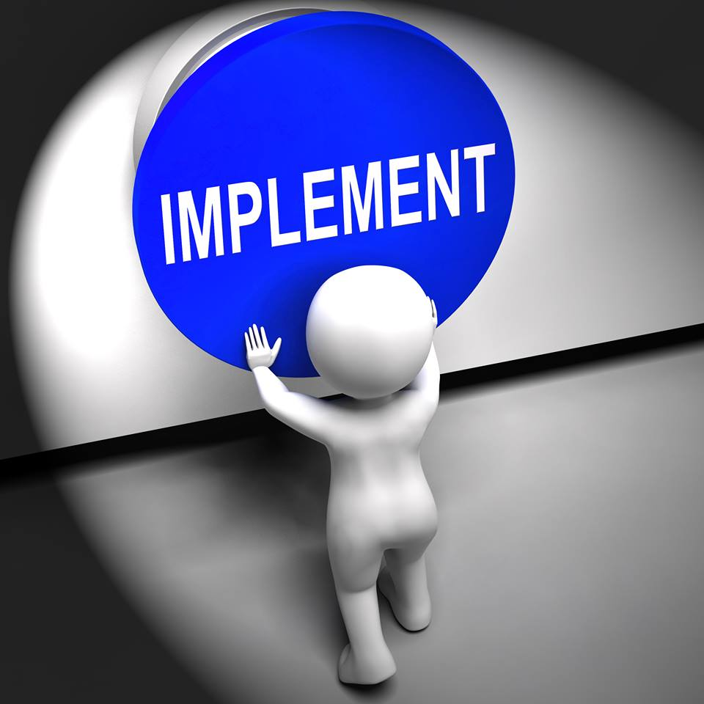
Implementation
Environment Development
Unity Asset Store and RAIN AI
Raspberry Pi Communication via Serial
Arduino swap for better communication support
Hand Constructed Wood and Acrylic Display
Circuitry and Full System Connectivity
P

Slide 11
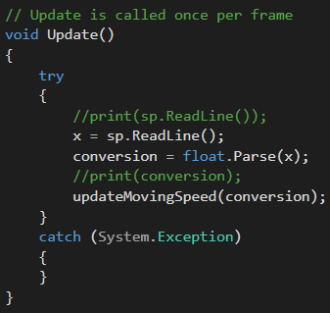
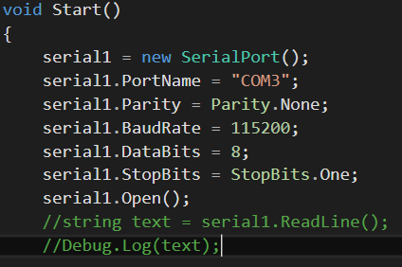
Some Code
P

Slide 12
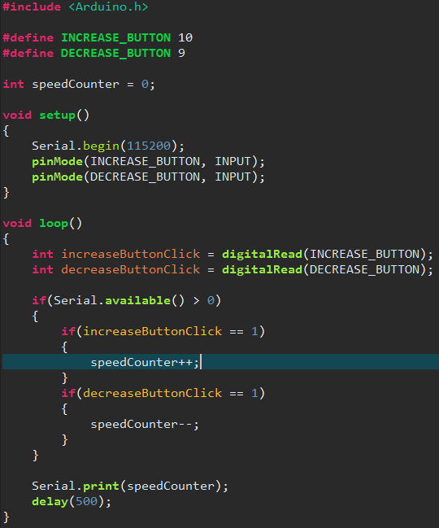
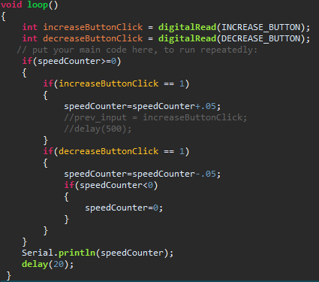
Some More Code
P

Slide 13
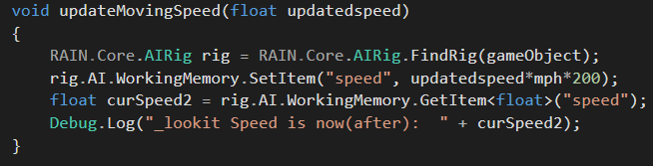
The Last of The Code
C

Slide 14

Problems Along the Way
Problem | Solution
Communication | Arduino and Serial
GPIO Library | Alter and then Remove
AI Path and Creation | Documentation, Research, Forums
Maneuvering Throughout Terrain | Mathematics and Trial and Error
Frames per Second | Field of View and Polygons
C

Slide 15
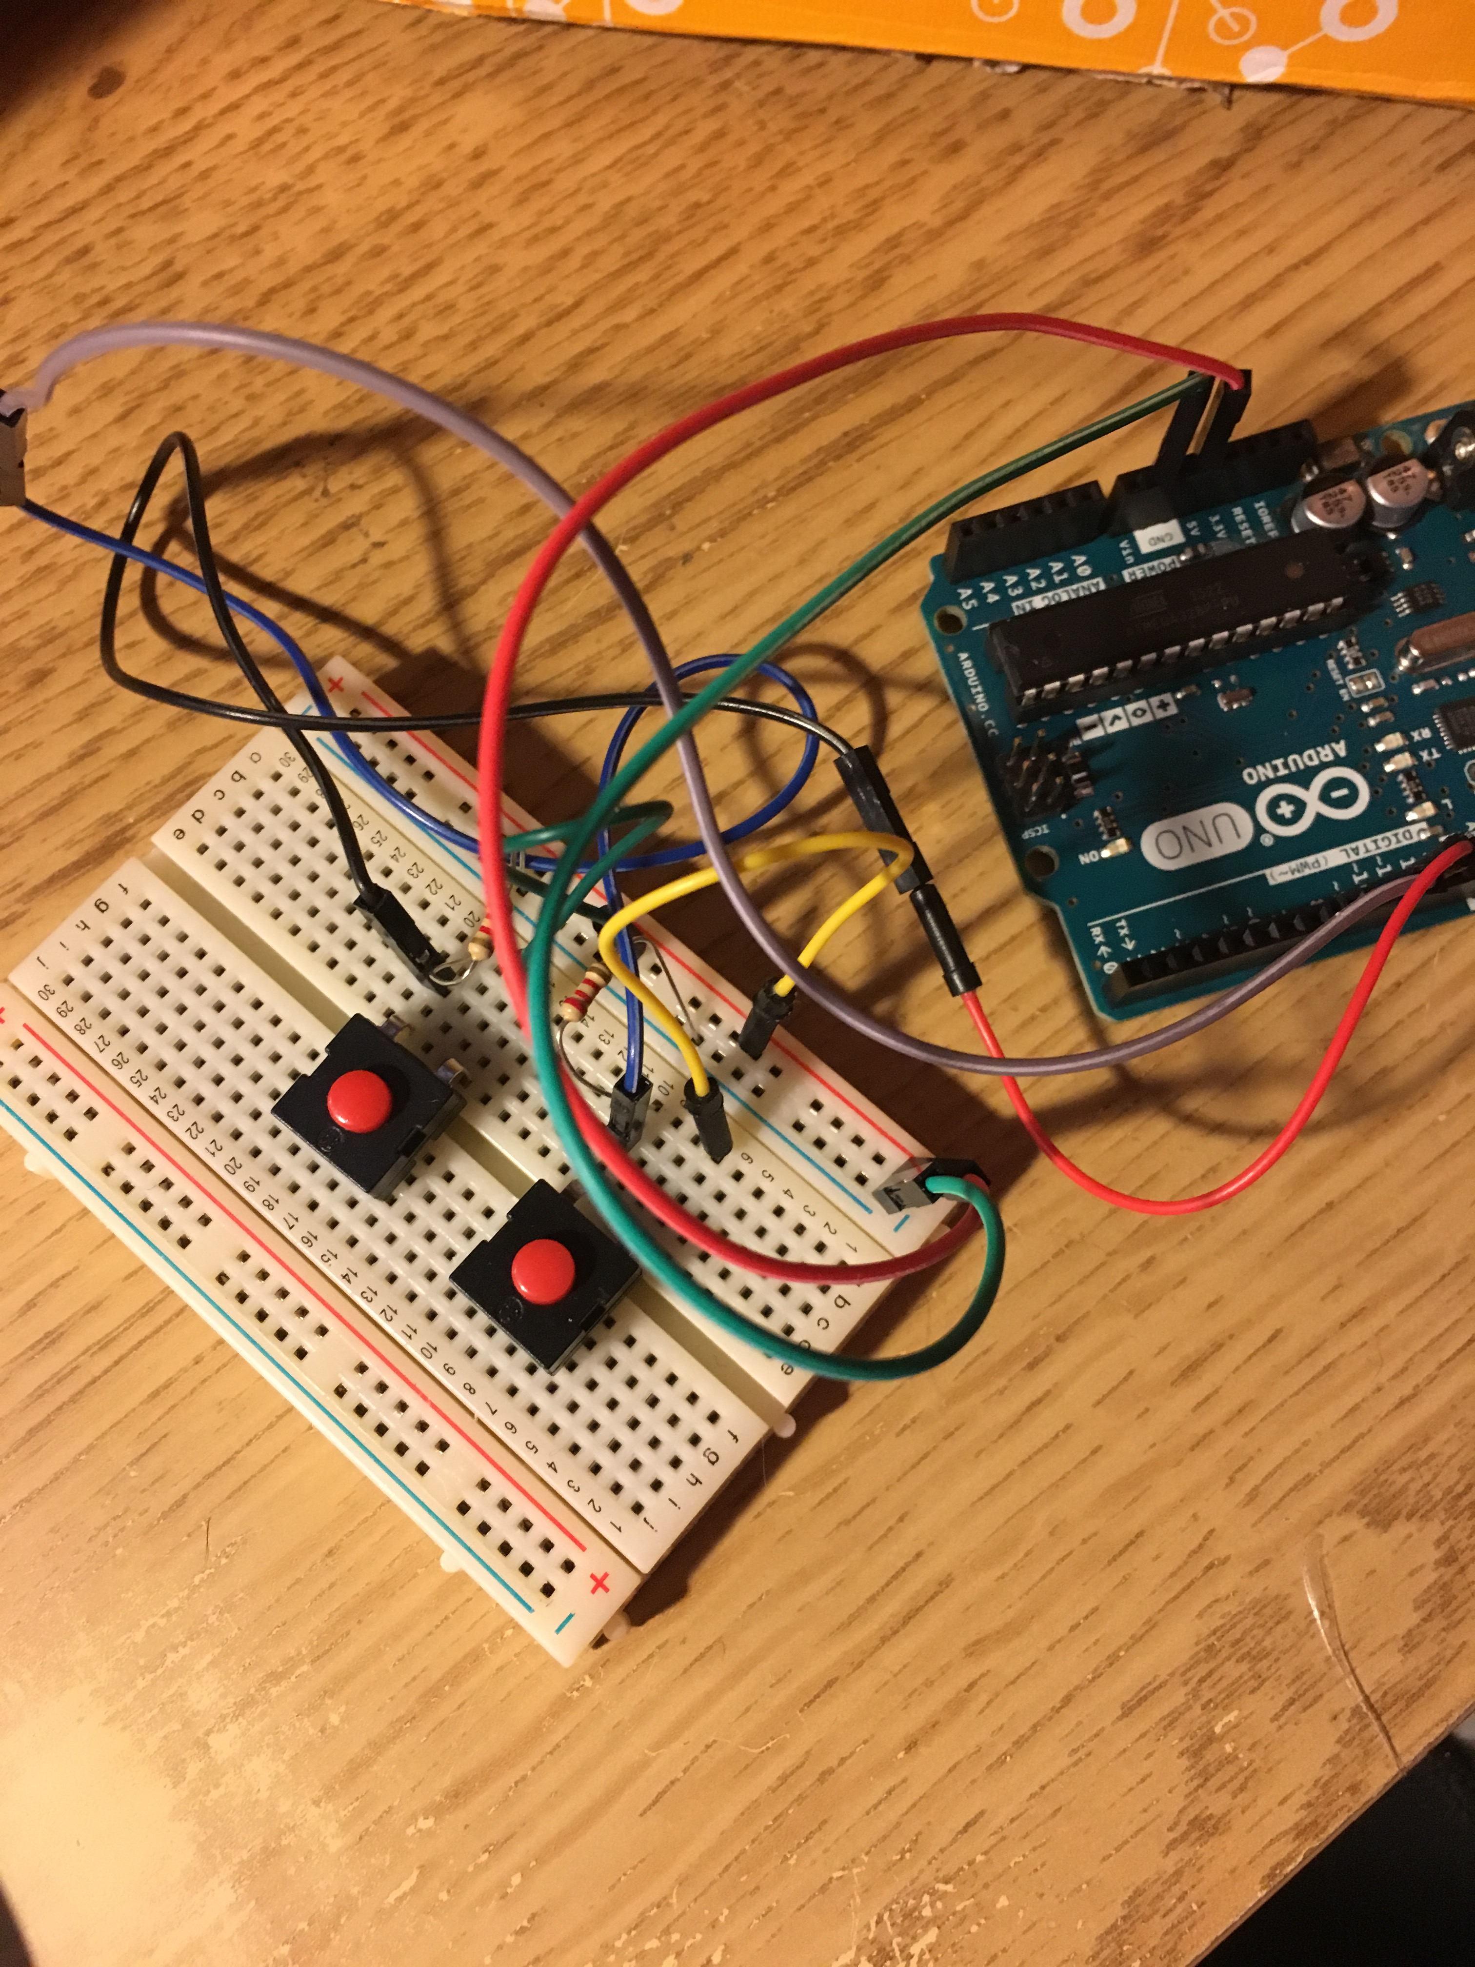
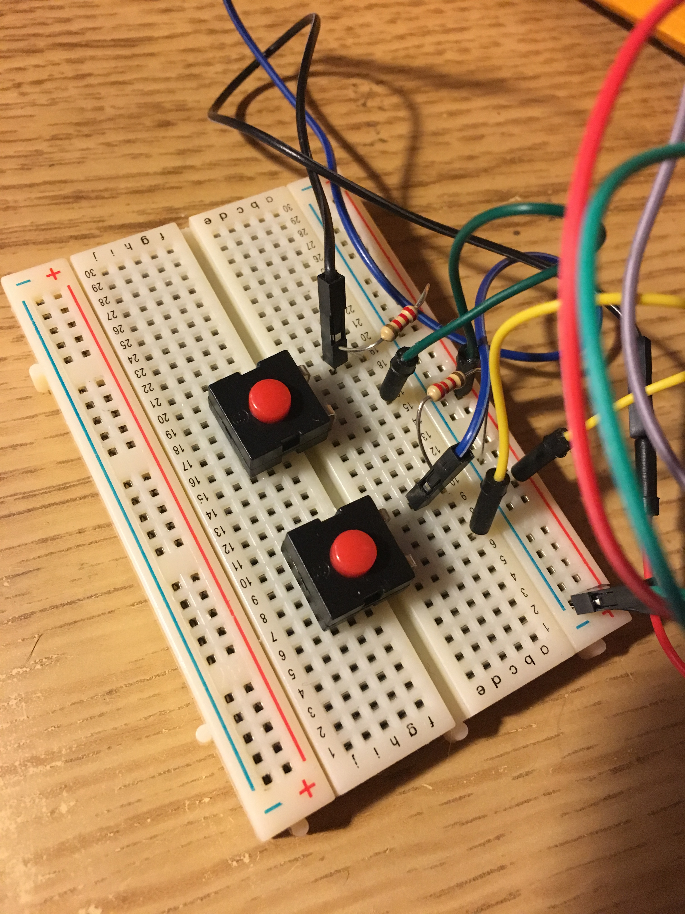
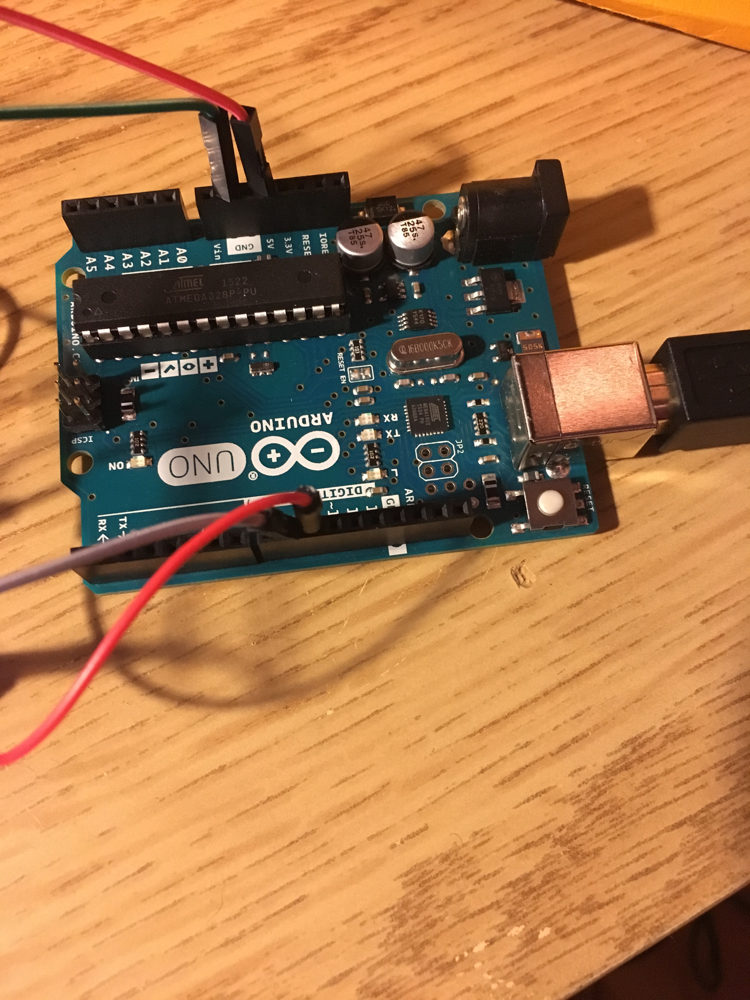
Demonstration
Decrease Speed
Increase Speed
C

Slide 16
Results
Created Minimum Viable Product for the Market Place
Potential CPXI Submission
Future Work:
Customizable GUI Application for iPhone/Android
Connection Directly from Treadmill to Program
Increasing and Decreasing Incline
Computerized “Ghost” of Best Time
Google Maps Integration
App Store of Pre-Made Terrains

Slide 17

Concluding Thoughts
Thank you Dr. Currie and Professor Lindo!
Thank you Computer Science Department, Lynda, and Dr. Krish!
Thank you Sharon Goldsmith and the iDEAHUB!

